Slide 1
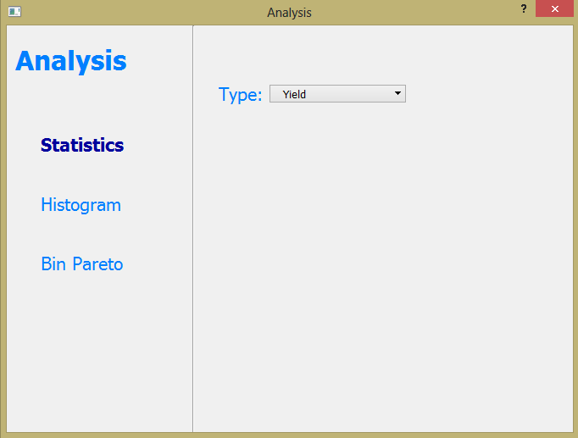
Statistics were chosen as an analysis type.

Slide 2
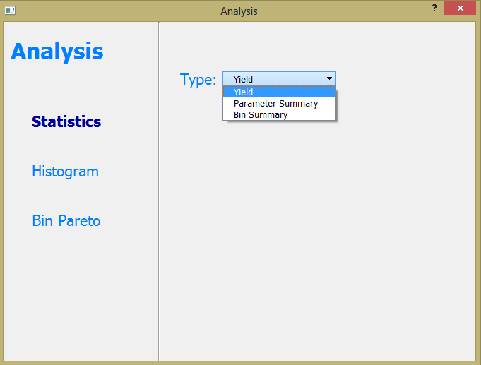
Statistics have three types of analysis Yield, Parameter Summary and Bin Summary.

Slide 3
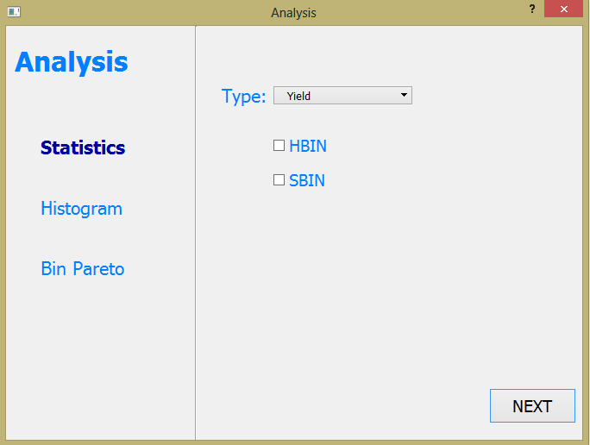
If the user wants to calculate Yield, s/he can also choose HBIN or SBIN or both of them.

Slide 4
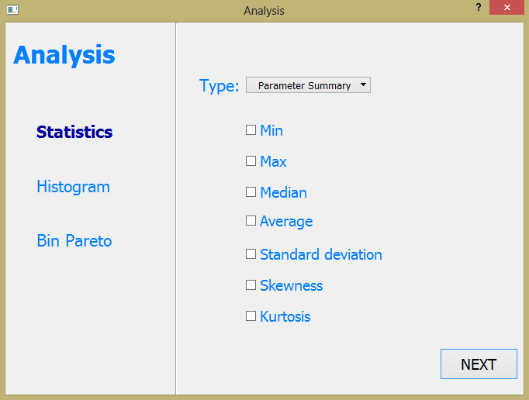
If the user prefers Parameter Summary, then the available choices are shown. The user can choose any number of them.

Slide 5
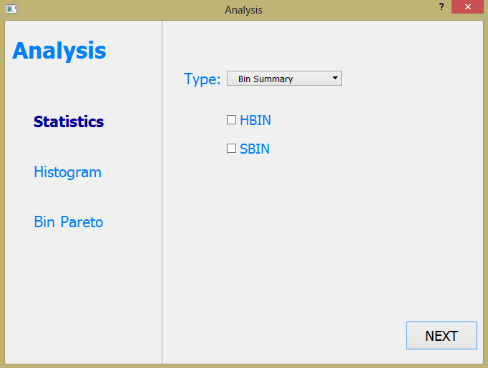
In case of Bin Summary, HBIN and SBIN are available for users.

